Slide 1

Northeastern University - Seattle
Computer and Information Sciences

Slide 2
Program Design Principles – PDP CS5010
Week 1 – Introduction to PDP

Slide 3
Overview
Aims of PDP
Logistics of PDP
Class exercise and discussion
Design by Contract

Slide 4
Course Primary Aims
At the end of this course you should be able to:
Design and build high quality software
Explain the major principles of the ‘art of programming’
Write understandable code
Be able to explain your design and code to your peers

Slide 5
Course Secondary Aims
You will also:
Have advanced knowledge and skills in Java, including Java 8.0 features
Be able to write concurrent Java programs
Have experience with a number of widely used Java components

Slide 6
High Quality Software
High quality software should be:
Correct
Comprehensible
Modifiable

Slide 7
Correct
Meet functional requirements
Pass test cases
Programming is not math
No one answer
But there are good ones and bad ones ☺
No single design method or approach
Programming is a design exercise
Apply design principles
Apply best practices such as design patterns
Justify and explain your thinking

Slide 8
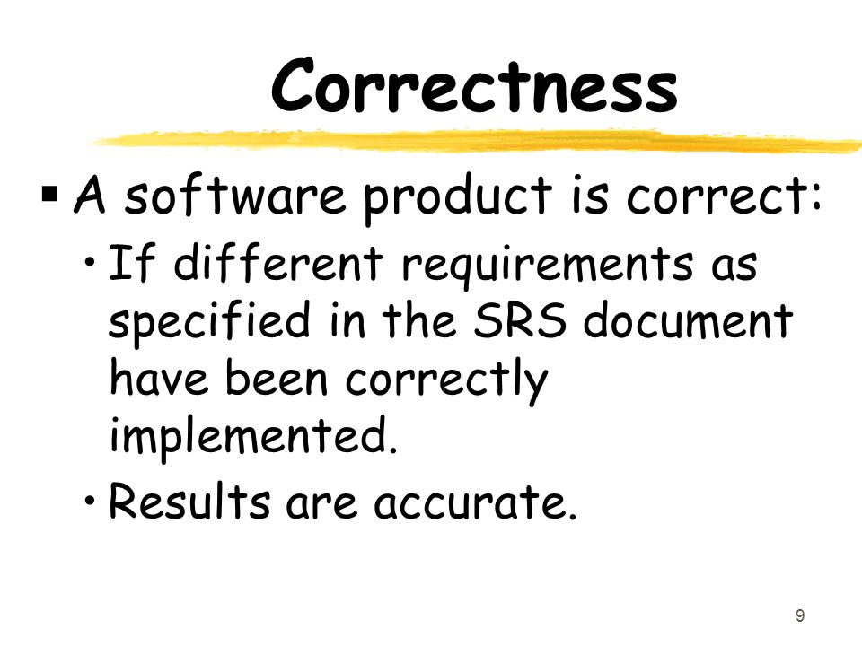

Slide 9
Comprehensible
Your code has two equally important audiences:
CPU and systems
Other engineers
Your code should be
Easy for others to understand
Well documented
This will be tested in walkthroughs
You’ll need to explain your design and code to TAs and Professors

Slide 10



Slide 11




Slide 12
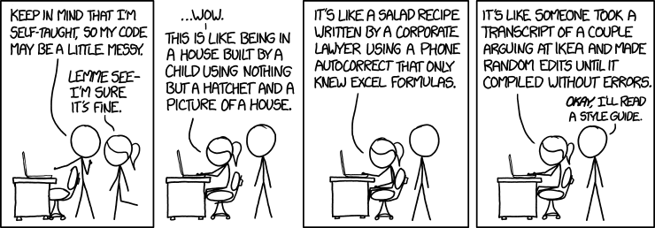

Slide 13
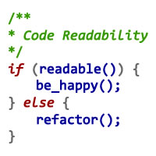

Slide 14
Modifiable
Software systems always change and evolve
Your code should be comprehensible so other engineers can use and modify it
Design principles make it possible to build modifiable software
But there are always trade-offs
Some changes are easier to make than others
And some will be hard/impossible
The art of design is to anticipate likely/most common changes and accommodate those

Slide 15


Slide 16
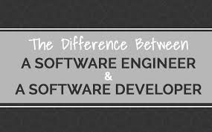
The end goal – Software Engineer

Slide 17
Software Engineering and Practice
Good software is not just the right output.
Many other goals exist.
"Software engineering" promotes the creation of good software, in all its aspects
Directly code-related: class and method design
Externally: documentation, style
Some of it is higher-level: system architecture
Software quality is important in this class AND in the profession

Slide 18


Slide 19
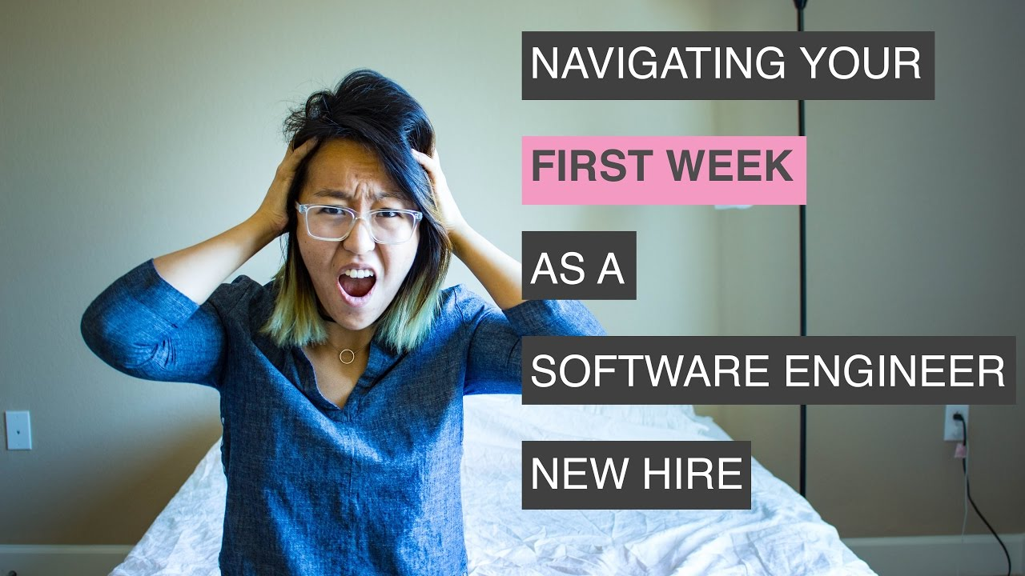

Slide 20
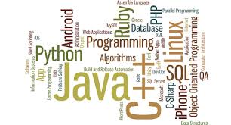
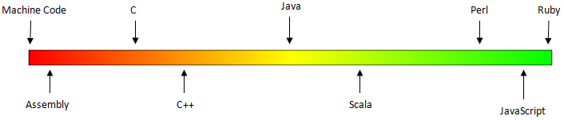
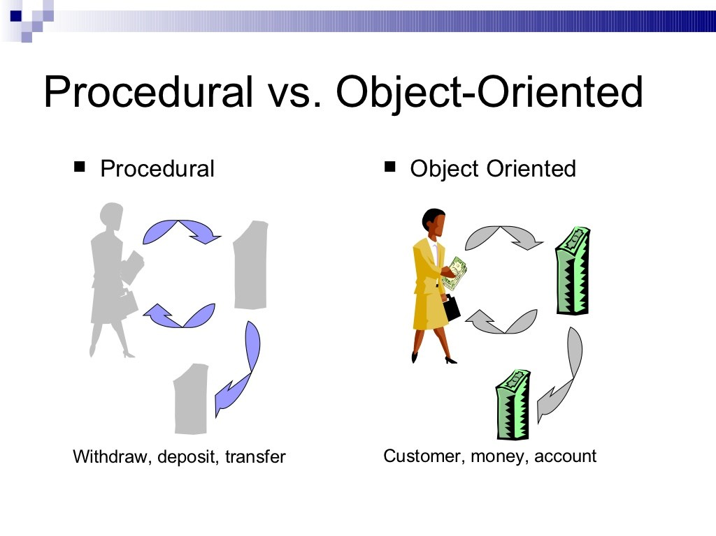
Some modern languages
Procedural languages: programs are a series of commands
Pascal (1970): designed for education
C (1972):low-level operating systems and device drivers
Object-oriented languages: programs use interacting "objects"
C++ (1985):"object-oriented" improvements to C
Java (1995):
Designed for embedded systems, web apps/servers
Runs on many platforms (Windows, Mac, Linux, cell phones...)
Notes:
Procedural Approach
Focus is on procedures
All data is shared: no protection
More difficult to modify
Hard to manage complexity
Advantages of Object Orientation
People think in terms of object
OO models map to reality
OO models are: Easy to develop & Easy to understand.

Slide 21
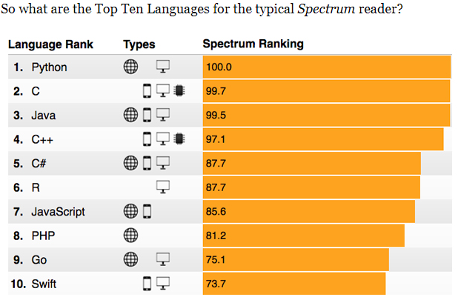
https://spectrum.ieee.org/ns/IEEE_TPL_2017/index/2017/1/0/0/1/1/50/1/50/1/50/1/30/1/30/1/30/1/20/1/20/1/5/1/5/1/20/1/100/

Slide 22
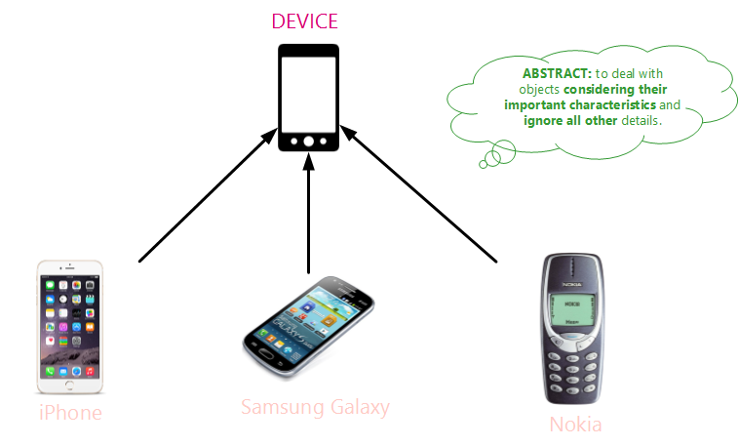
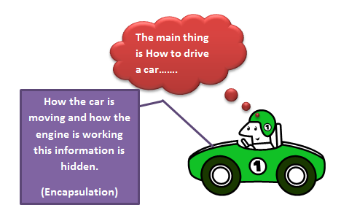
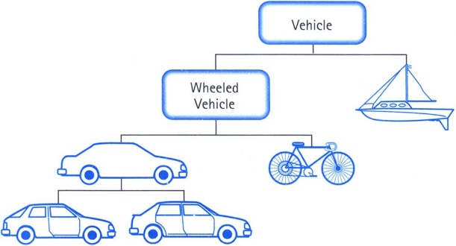
Object Oriented Principles
Abstraction
Encapsulation
Object’s data cannot be accessed
directly from outside the object
Inheritance - “Is-a” relationship
Polymorphism – objects with the same
specification have different implementation
Notes:
` Abstraction is a fundamental principle of software development that allows to reduce coupling between software modules. ● Abstraction is formulation of generalized concept disregarding not important features, properties and relations in order to focus on distinctive features. ● Abstraction captures only those details about an object that are relevant to the current perspective.
Abstraction is an interface to data type or functionality and can have multiple implementations. ● Concrete implementation is never referenced directly and can be replaced with another implementation without requiring changes in client code. ● Client code should depend on abstraction, not the particular implementation
Encapsulation means that the data that an object contains cannot be accessed directly from outside that object, and its representation is invisible from outside the object. It is a great way to develop a loosely coupled software components.
Polymorphysm Polymorphysm (from Greek polys, "many, much" and morphē, "form, shape") is the possibility of objects with the same specification to have different implementation.
Polymorphism:
Overloading (compile time polymorphism): methods have the same name but different parameters.
Overriding (run time polymorphism): the implementation given in base class is replaced with that in sub class.

Slide 23
PDP Logistics

Slide 24
Content Overview
We will be using Java
Next week – Whirlwind Tour of Java
After that we assume Java competence
Advanced OO Design Principles and Patterns
Data Structures and Algorithms
Concurrency
Functional programming
Networking and distribution

Slide 25
Web Site
https://cs5010pdp2017fall.github.io/

Slide 26
Lectures
Each lecture will be a mix of presentation and class exercises
We’ll expect you to have done the recommended reading associated with each week

Slide 27
Assignments
9 programming assignments
6x1 week
3x2 weeks (these are obviously harder!)
First 4 assignments are solo
Last 5 are in pairs
We choose the partners ☺

Slide 28
Assessment
Code submission due Mondays at 6pm on weeks of deadlines
Tuesday – walkthroughs held where you explain your code to TAs/Professors
Logistics for walkthroughs coming soon

Slide 29
Assessment Grade
30% - correctness
Pass tests
Produce correct output
20% - presentation of solution
50% - design
See web site for specifics.

Slide 30




Professors – You have 4 ☺
Ian
Tamara
Adrienne
Maria

Slide 31

And many TAs …..

Slide 32
Class Exercise

Slide 33
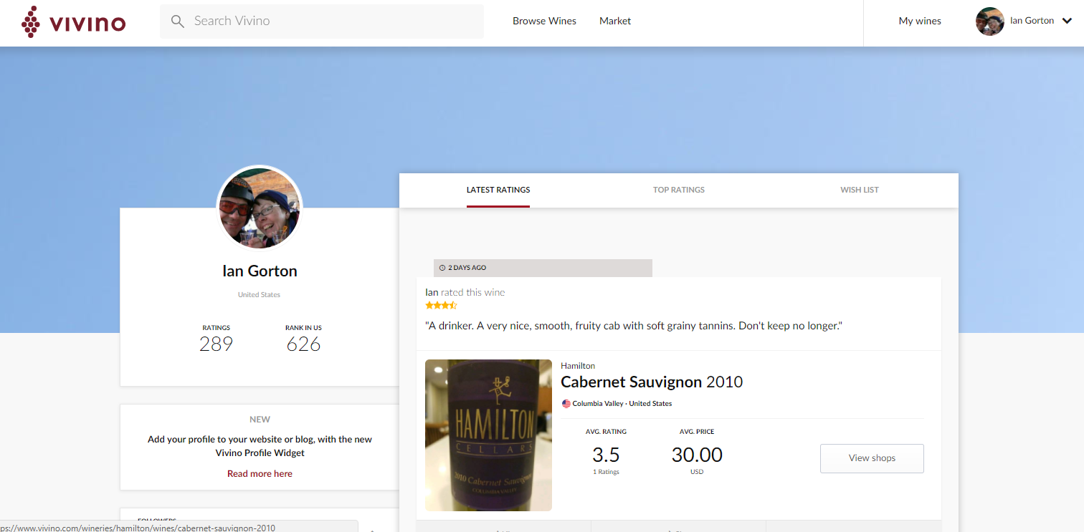
Vivino.com

Slide 34
Vivino
Database of knowledge about wine worldwide
Wine producers
The wines they produce
Retailers that sell each wine
Classification of all wines into ~250 categories
Users rate wines they drink
Rating and comments
Other users can ‘Like’ ratings
Users can follow others (followed by/followers)
Users get rankings based on number of reviews

Slide 35
Exercise
In groups of 2 or 3, discuss:
What are the major abstractions in this problems domain
E.g. Classes
How are they are related?
Associations/compositions
Dependencies (one way/two way?)
Remember – this is a client server app
Server lives ‘in the cloud’, shared by ….
(Typically) mobile client apps

Slide 36
Design By Contract

Slide 37
Programming ‘in the Small’ versus ‘in the large’
Small programs (e.g a few hundred LoCs)
Easy to write
Easy to fully understand
Easy to change
Big programs (e.g. 1 million LoCs)
Hard to write
Impossible to fully understand
Hard to change

Slide 38
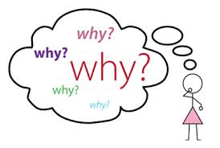

Slide 39

The Ripple Effect
A seemingly simple change leads to many unexpected changes
The parts of the programs are dependent upon each
Change one, must change many
Tightly coupled
The number of interactions/dependencies makes code unmanageable

Slide 40
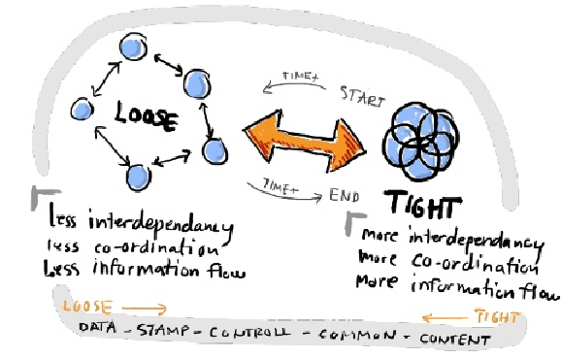

Slide 41
Modularity
Decompose the problem into parts
Modules, packages, classes, components, etc
Create minimal dependencies between the parts
Loosely coupled, limit ripple effect
Dependencies based on specifications
Hide implementation details from other parts
Details can change as long as specification not violated

Slide 42
Specification
Defines a contract between a ‘using’ class and a ‘used’ class
E.g client, server
Describes expectations of each other
What data the client must pass to the server
What effects passing the expected data will have on the server
What the server will return to the client
What conditions can be guaranteed to hold after the request is complete

Slide 43
Why not just read the code?
Code is complicated!!
And changes
Specification concisely tells the client what the code does, not how it does it
Specification abstracts away unnecessary details
Easy to understand, clear and unambiguous
Specifies what the client can always depend on when using the module

Slide 44
Elements of a contract
Preconditions of the module
What conditions the module requests from its clients
Check upon entry to module
Postconditions of the module
What guarantees the module gives to clients
What conditions must hold for all objects of this module if implemented correctly

Slide 45
Violations
Precondition violation
Blame the client
Postcondition violation
Blame the server
In reality we have a bug

Slide 46
Example – A fixed size stack
Push(T t)
Precondition: stack is not full
Postcondition: numElem = numElem’+1
Stack[numElem] = t
numElem >= 0 and <= max
T Pop()
Precondition: stack is not empty
Postcondition: numElem =numElem’-1
Postcondition: Returns Stack[numElem’]
numElem >= 0 and <=max
Module Invariant

Slide 47
When to check?
Preconditions
Upon module entry
Or as early as feasible
Throw an exception if violated
Postconditions
Just before returning
Violations indicate errors in the module
Useful for debugging
In production?

Slide 48
Using Javadoc
Javadoc can be used for writing specification
Method signature
Text description of method
@param: description of what gets passed in
@return; description of what gets returned
@throws: exceptions that may occur
http://www.oracle.com/technetwork/articles/java/index-137868.html

Slide 49
Example
/**
* Returns an Image object that can then be painted on the screen.
* The url argument must specify an absolute {@link URL}. The name
* argument is a specifier that is relative to the url argument.
* <p>
* This method always returns immediately, whether or not the
* image exists.
*
* @param url an absolute URL giving the base location of the image
* @param name the location of the image, relative to the url argument
* @return the image at the specified URL
*/
public Image getImage(URL url, String name) {
try {
return getImage(new URL(url, name));
} catch (MalformedURLException e) {
return null;
}
}

Slide 50
To specify a contract, we’ll add …
@precondition: specify all obligations on the client. These must hold before method call
@postcondition: specify conditions that must hold at end of method for correct execution

Slide 51
Example (not correct Javadoc for brevity)
static void listAdd(List lst1, List lst2)
@precondition: lst1 and lst2 are non-null.
@precondition: lst1 and lst2 are the same size.
@postcondtion: lst1[i] = lst1[i] + lst2[i]
@return none

Slide 52
One for you ….
Public class Vivino {
public Credentials login(String user, String pwd) {}
public WineList getMyWines (Credentials user) {}
public Receipt buyWines(WineList selectedWines) {}
public bool payForWine(CreditCard cc) {}
}

Slide 53
What Next
Get your Java IDE environment configured
Become a Java expert
You have a week ☺
Your bedtime reading
Joshua Bloch, Effective Java 2nd Edition

Slide 54
What Next (2)
First assignment released on Friday
Lecture next week – Whirlwind Java tour
First assignment deadline:
Monday 6pm Sept 18th
First Walkthroughs
Tuesday 19th Sept
Time slots all day, sign up ‘sheet’ coming soon

Slide 55


